Slide 1
Patterns of Contamination
Overview: The graphs display monthly sample patterns collected from specific locations, highlighting both similarities and differences.
Findings:
Boonsri: Shows consistent pattern similarities in data when samples are taken downstream from the water flow.
Chai: Demonstrates a similar pattern to Boonsri, indicating comparable environmental factors.
Kannika: Also aligns with Boonsri's monthly sample trends, suggesting regional consistency.
Exceptions:
Busarakhan: Lacks pattern similarities observed in Boonsri, Chai, and Kannika.
Kohsoom: Shows pattern alignment similar to Boonsri, indicating a possible influence of nearby environmental changes.
Conclusion: The observed similarities, except for Busarakhan, suggest a potential event near the estimated waste dump location, influencing water flow and sample characteristics.

Slide 2
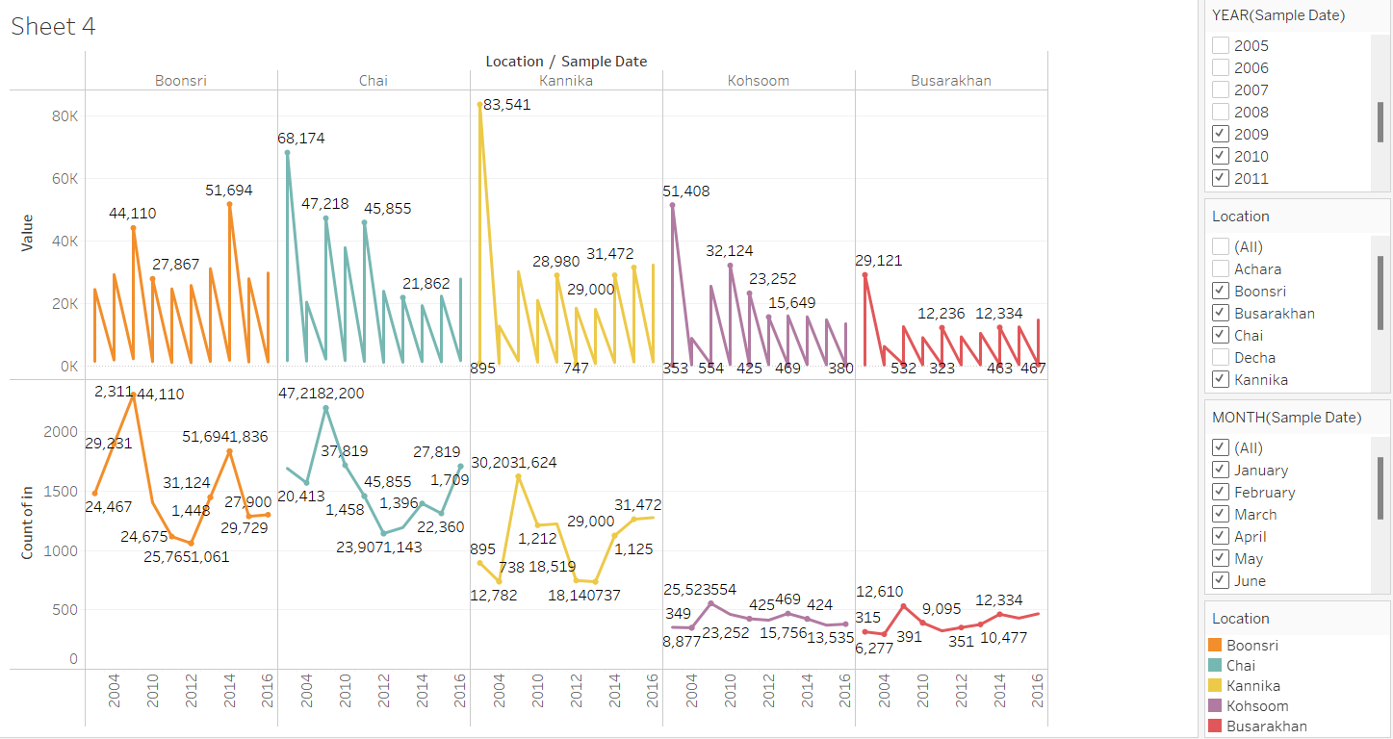

Slide 3
Overview of Toxic Elements in Different Locations
This treemap visualizes the concentration of several toxic elements—Cadmium, Arsenic, and Alachlor—in locations such as Boonsri, Chai, and Kannika. The darker and larger rectangles represent higher concentrations of each element.
Toxic Elements and Their Impact on Aquatic Life
Cadmium:
Bioaccumulates in fish, causing reproductive and immune issues.
Lethal even in low doses over time.
Arsenic:
Disrupts growth and damages fish gills.
Toxic at low levels and builds up in the food chain.
Alachlor:
Harms aquatic plants essential for oxygen and habitat.
Affects fish growth and reproduction.

Slide 4
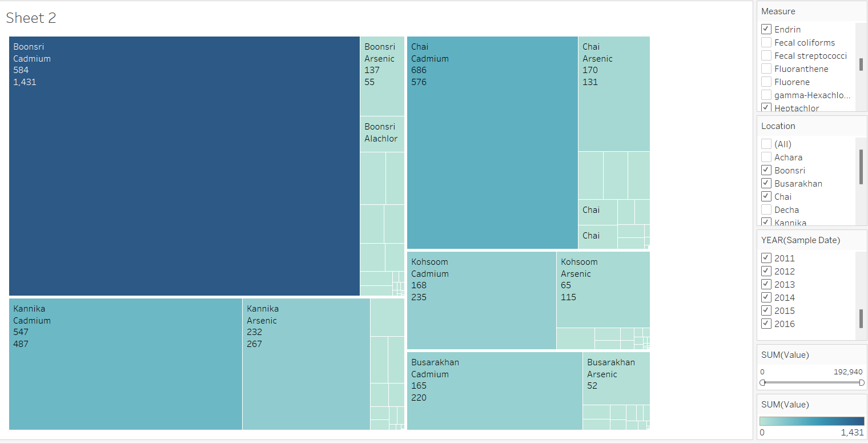

Slide 5
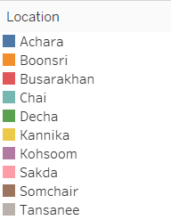
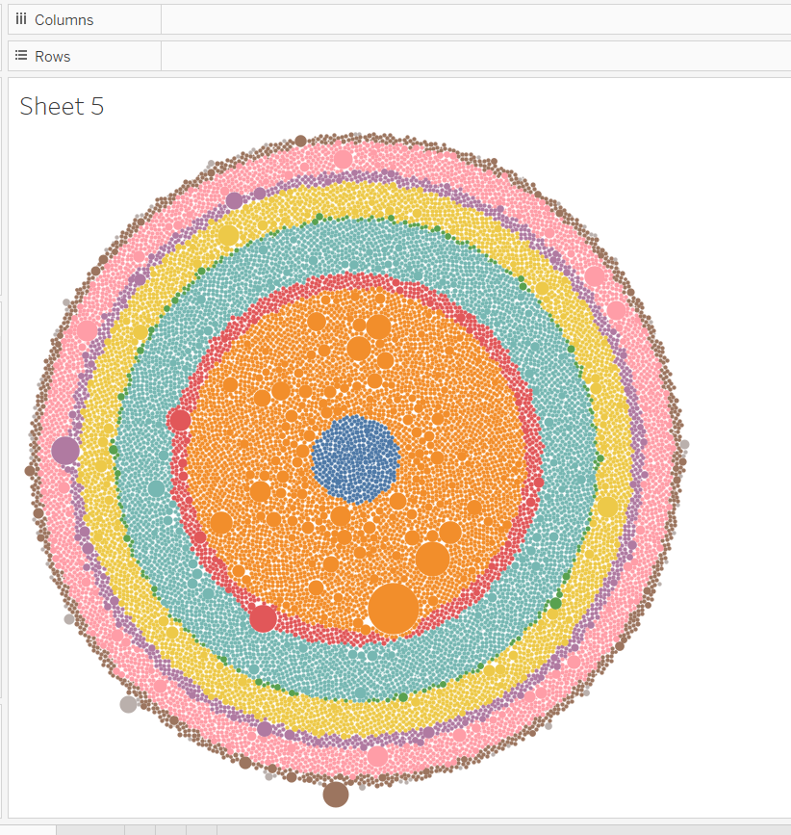
Visual Analysis: This chart visualizes the quantity of toxic elements detected in water samples from various locations, with darker shades indicating higher concentrations.
Key Toxic Elements Contributing to Water Contamination:
Cadmium - Interferes with fish reproduction and weakens immune systems.
Arsenic - Damages gills, accumulates in aquatic life, and is toxic at high levels.
Alachlor - Harms aquatic plants and disrupts fish growth.
Fluoranthene - Carcinogenic, affects fish liver function and increases mortality.
Heptachlor - Damages nervous systems in fish and other aquatic species.
Endrin - Extremely toxic, causing paralysis and mortality in aquatic animals.

